Slide 1

Website Portfolio
Robert Thomas

Slide 2
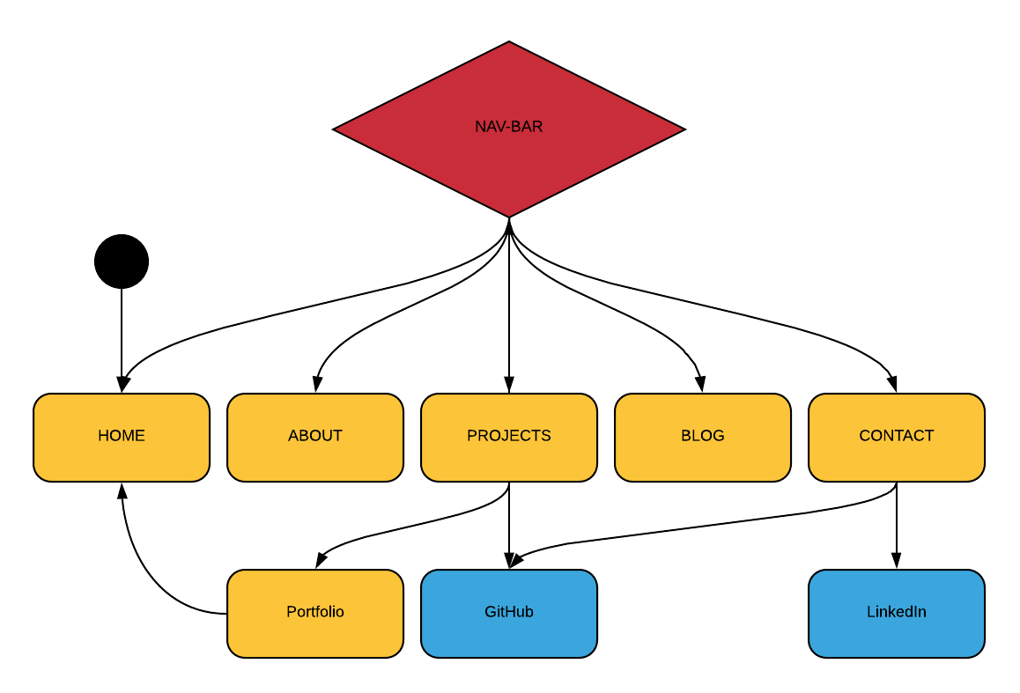
Sitemap: The nav-bar allows access to all main pages of my website wile some links can take the user to other websites.

Slide 3
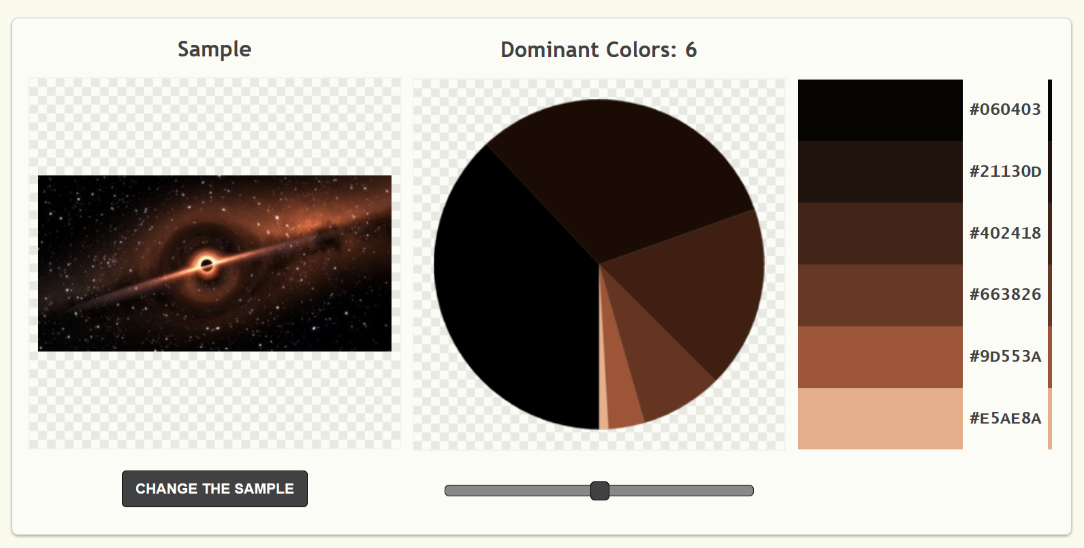
Design Process:
1. Browse websites for inspiration
2. Picked a picture with an interesting visual point without detracting from the content
3. Used that picture to generate a colour pallet

Slide 4
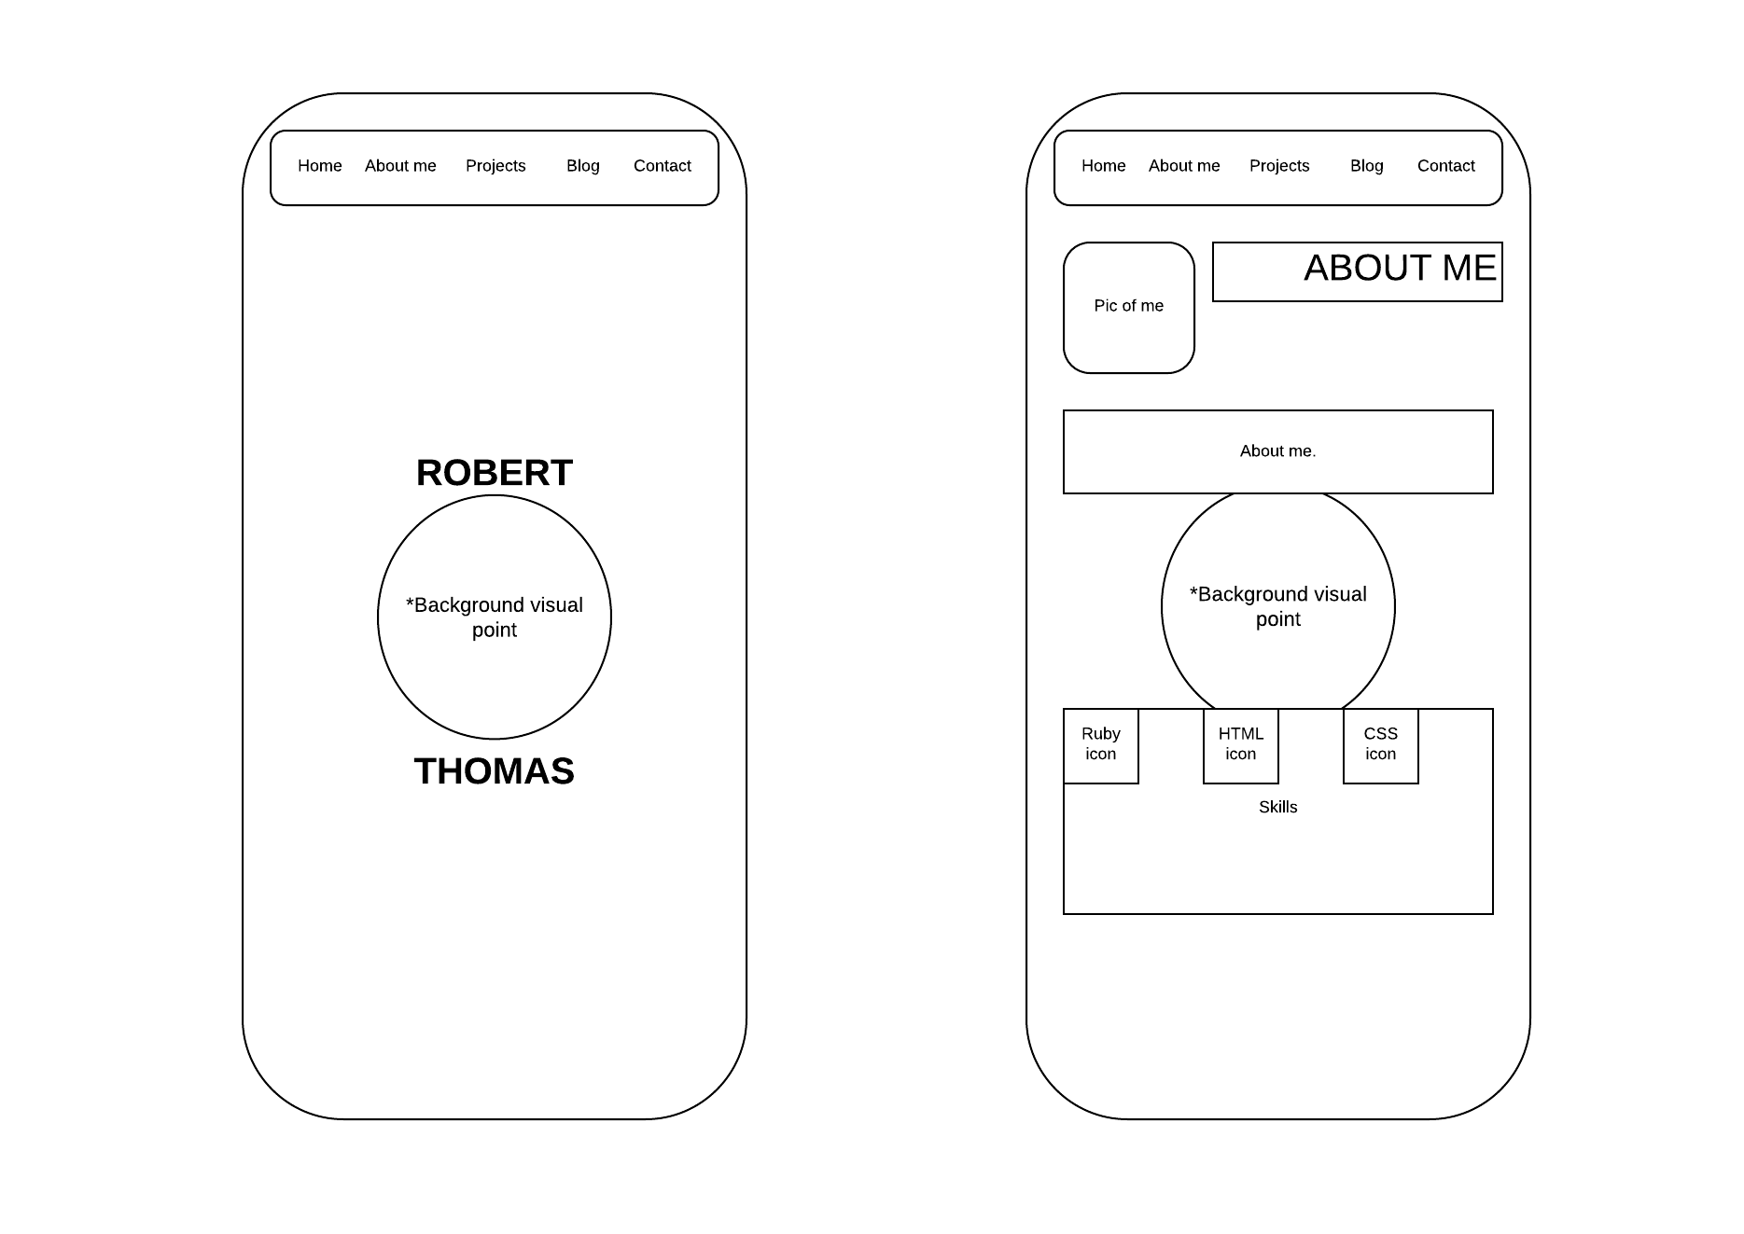
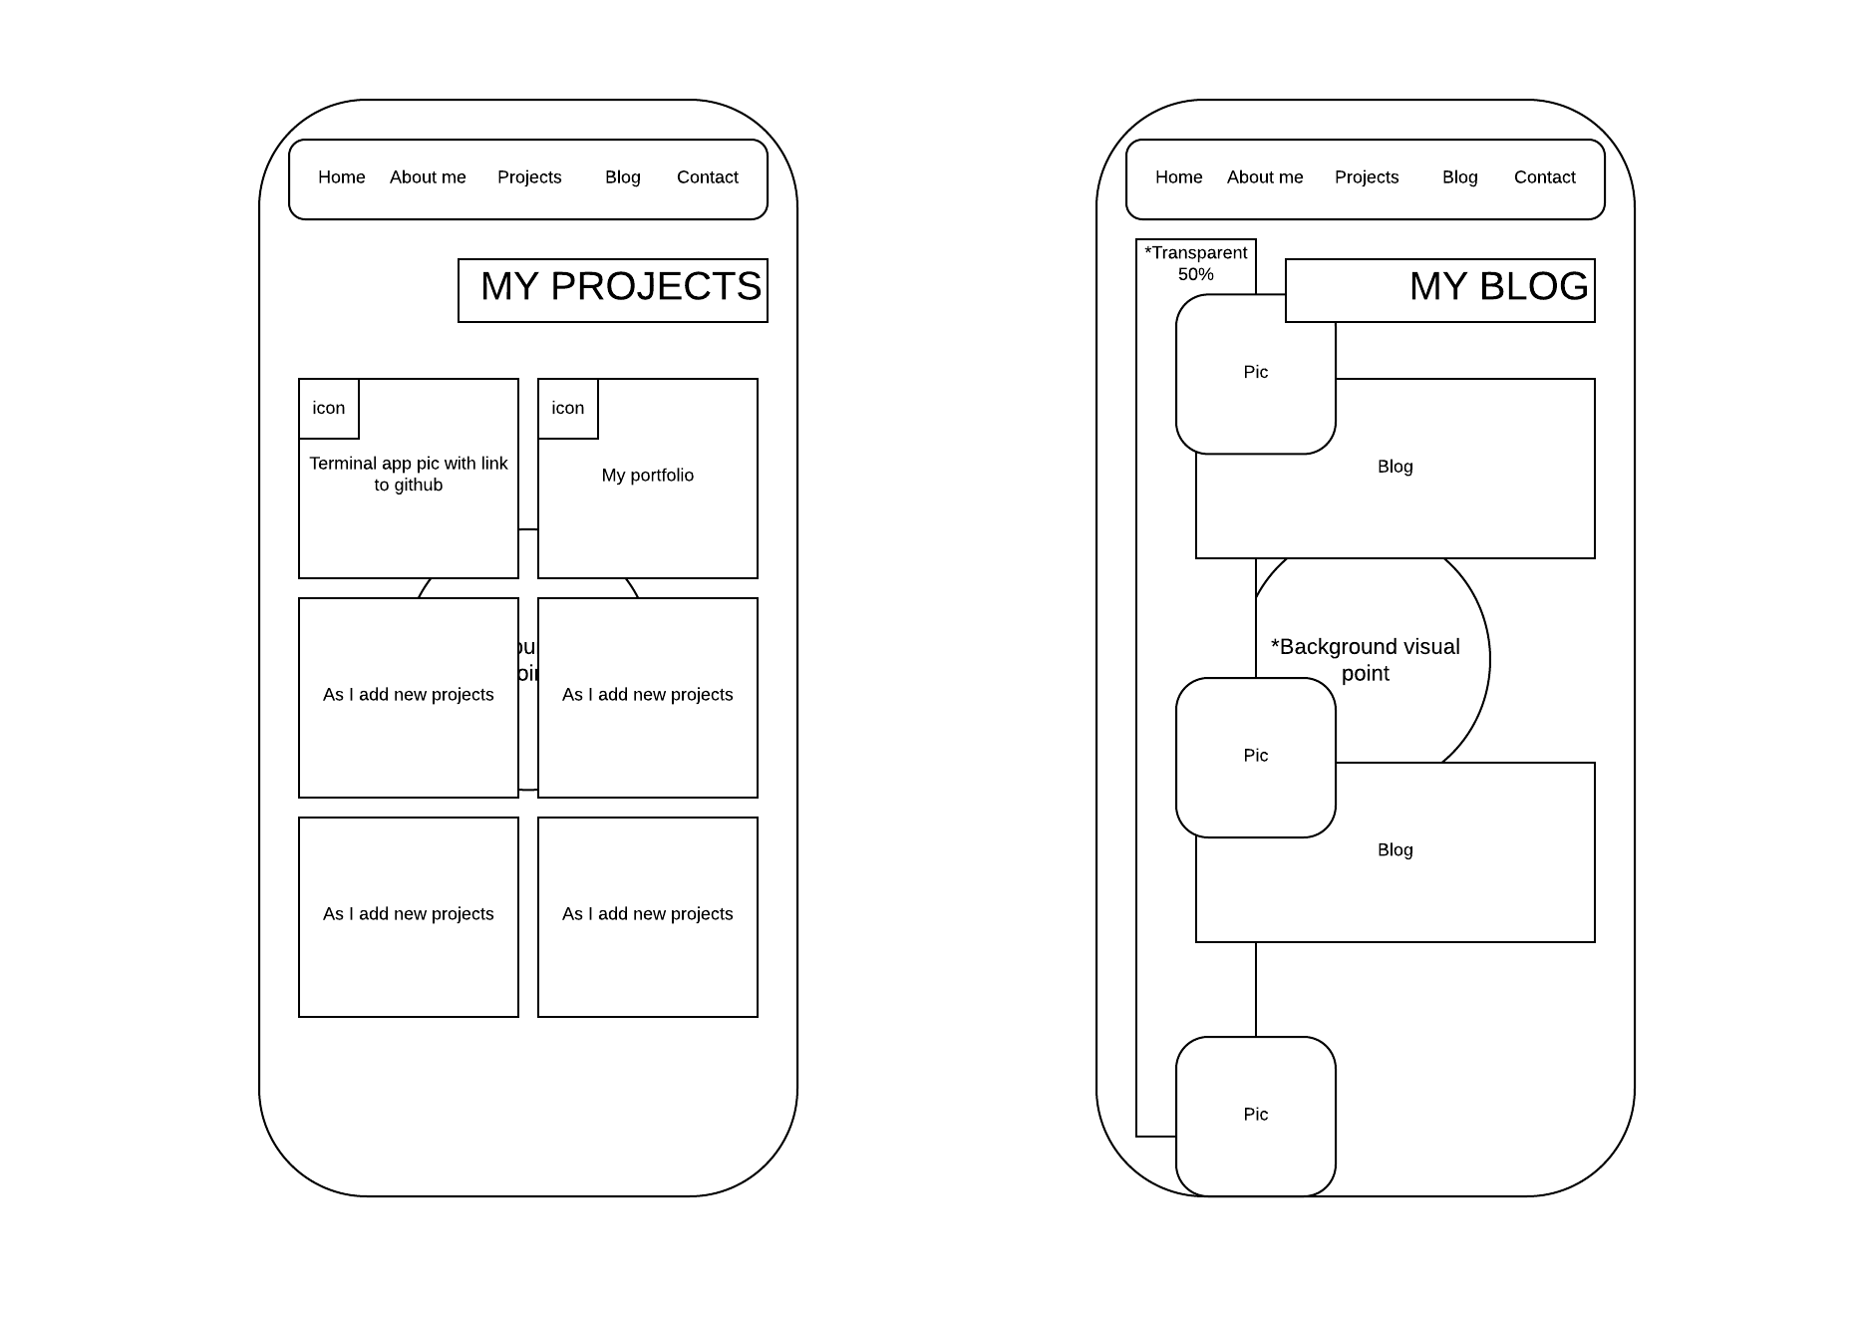
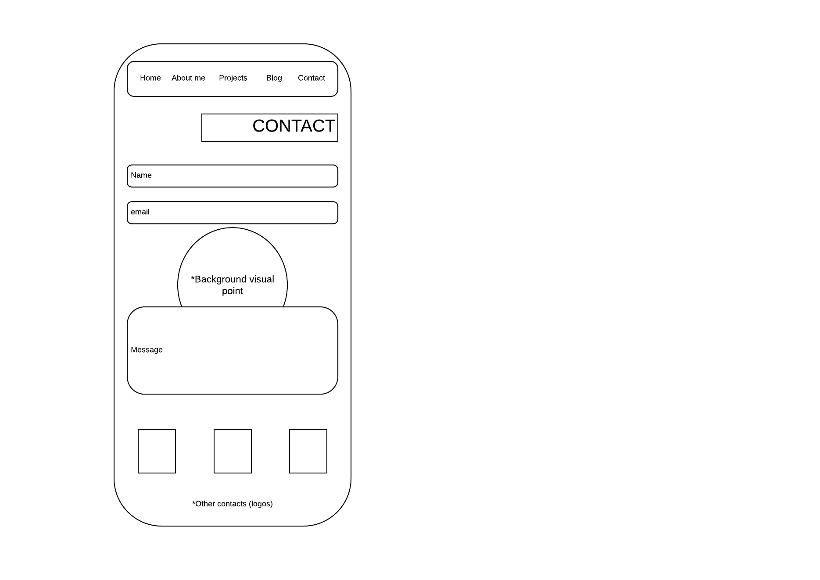
Design Process:
Designed wire-frames with mobile in mind then applies some max width rules in my css to optimise it for viewing on monitors.

Slide 5
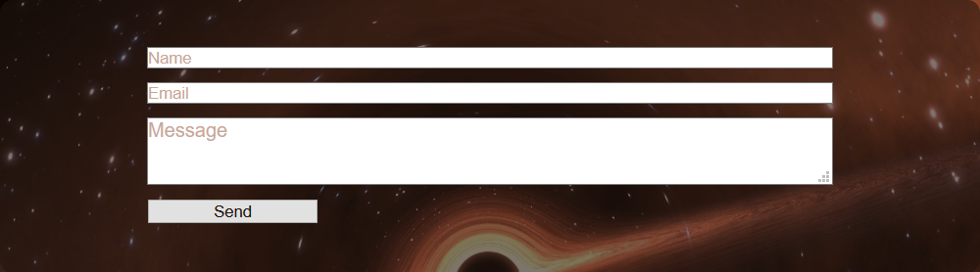
Components:
- Static Nav-Bar located at top of page
- Form for contacting as well as a send button
Images:
- Self image for about me page
- Images for blog section
- Images to represent links to projects
- Visual icons for skills, and clickable icons for contacting

Slide 6
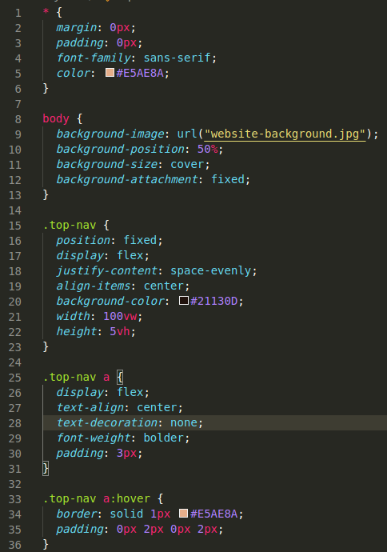
Development Process:
- Wrote out a basic template for HTML
- Filled out content temporarily with Lorem and created divs to place images in on each page
- Wrote out a CSS template to apply a basic style and structure to each page
- Go through page by page and apply CSS to organise content
- Replace placeholder lorem with actual content
- Insert image into html
- Dear god why? Stop doing that, that isn’t what you’re meant to do!
- Spend a long time trying to fix image sizes
- Touch ups

Slide 7
Challenges:
- Learning to use the dev tools (have never used them before now)
Why is that div not holding the image? Oh because I didn’t set dimensions for the div holding the div, holding the div…
- Writing documentation
- Everyone having fun in my house while I study ☹
- This dining room chair

Slide 8
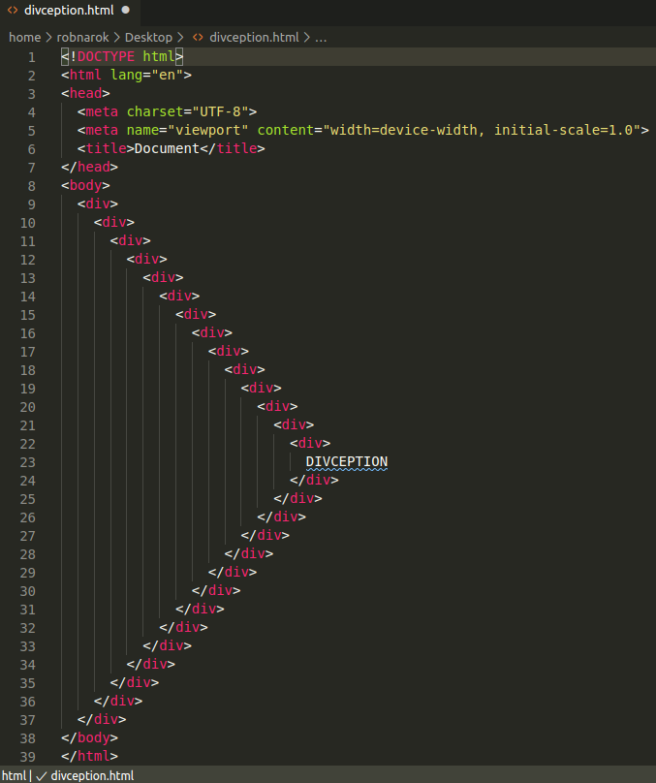
Favourite Parts:
- Using CSS to structure the site
- Collaborating with others to work out problems
- Those “Ah-ha!” moments
- Getting to make something with a real function
- Working on something visual

